Slide 1
ML Pipeline
Tech Session

Slide 2
Train Examples
Labels
Validate Examples
Labels

Slide 3
Features Data
Train Examples
Labels
Validate Examples
Labels

Slide 4
Time Splitter

Slide 5
Time Splitter
Cohort Creator
Database

Slide 6
Time Splitter
Cohort Creator
Label Creator
Database

Slide 7
Time Splitter
Cohort Creator
Label Creator
Feature Creator
Database

Slide 8
Time Splitter
Cohort Creator
Label Creator
Feature Creator
Matrix Creator
Database

Slide 9
Time Splitter
Cohort Creator
Label Creator
Feature Creator
Matrix Creator
Model Trainer
Database

Slide 10
Time Splitter
Cohort Creator
Label Creator
Feature Creator
Matrix Creator
Model Trainer
Database
Score Predictor

Slide 11
Time Splitter
Cohort Creator
Label Creator
Feature Creator
Matrix Creator
Model Trainer
Database
Score Predictor
Model Evaluator

Slide 12
config.yaml
Pipeline Runner
Orchestration + Config Parameters
Time Splitter
Cohort Creator
Label Creator
Feature Creator
Matrix Creator
Model Trainer
Database
Score Predictor
Model Evaluator

Slide 13
config.yaml
Pipeline Runner
Orchestration + Config Parameters
Time Splitter
Cohort Creator
Label Creator
Feature Creator
Matrix Creator
Python + SQL
Model Trainer
Database
Python
Score Predictor
Model Evaluator

Slide 14
config.yaml
Pipeline Runner
Orchestration + Config Parameters
Time Splitter
Cohort Creator
Label Creator
Feature Creator
Matrix Creator
Model Trainer
Database
Score Predictor
Model Evaluator

Slide 15
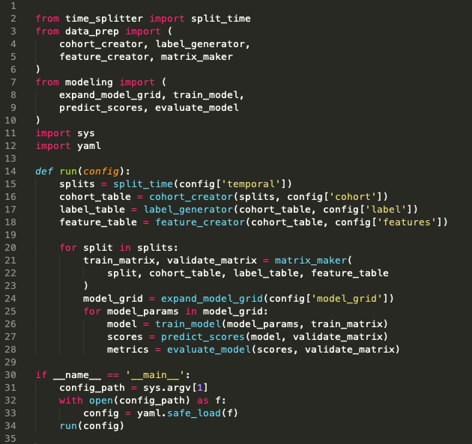
Pipeline Runner

Slide 16
config.yaml
Pipeline Runner
Orchestration + Config Parameters
Time Splitter
Cohort Creator
Label Creator
Feature Creator
Matrix Creator
Model Trainer
Database
Score Predictor
Model Evaluator

Slide 17
Time Splitter
Features Data
Train Examples
Labels
Validate Examples
Labels

Slide 18
Time Splitter
Features Data
Train Examples
Labels
Validate Examples
Labels
Features Data
Train Examples
Labels
Validate Examples
Labels
Features Data
Train Examples
Labels
Validate Examples
Labels
Features Data
Train Examples
Labels
Validate Examples
Labels
•
•
•

Slide 19
Time Splitter
INPUTS
Temporal Parameters:
Beginning of time
End of time
Label Window
Example History
Update Frequency
OUTPUTS
Paired train/validate sets of dates:
[
(train_start_1, train_end_1),
(test_start_1, test_end_1)
],
[
(train_start_2, train_end_2),
(test_start_2, test_end_2)
], …
Note: Not splits of the data!
(you still need the full history for features)

Slide 20
config.yaml
Pipeline Runner
Orchestration + Config Parameters
Time Splitter
Cohort Creator
Label Creator
Feature Creator
Matrix Creator
Model Trainer
Database
Score Predictor
Model Evaluator

Slide 21
Cohort Creator
INPUTS
Train/validate split dates
Cohort logic
(e.g., SQL snippet in config)
Cleaned data
OUTPUTS
Sets of entities at a given time that will define rows in training/validation matrices:
entity_id, time

Slide 22
config.yaml
Pipeline Runner
Orchestration + Config Parameters
Time Splitter
Cohort Creator
Label Creator
Feature Creator
Matrix Creator
Model Trainer
Database
Score Predictor
Model Evaluator

Slide 23
Label Creator
INPUTS
Train/validate split dates
Cohort ids+dates
Label definition logic + window
(e.g., via SQL snippet in config)
Cleaned data
OUTPUTS
Label values for each entity/date pair in the cohort:
entity_id, date, label(s)

Slide 24
config.yaml
Pipeline Runner
Orchestration + Config Parameters
Time Splitter
Cohort Creator
Label Creator
Feature Creator
Matrix Creator
Model Trainer
Database
Score Predictor
Model Evaluator

Slide 25
Feature Creator
INPUTS
Train/validate split dates
Cohort ids+dates
Feature definition logic + windows
(e.g., via SQL snippets in config)
Cleaned data
OUTPUTS
Feature values for each entity/date pair in the cohort:
entity_id, date, feature cols
Note: often useful to group related features together for testing, etc.

Slide 26
config.yaml
Pipeline Runner
Orchestration + Config Parameters
Time Splitter
Cohort Creator
Label Creator
Feature Creator
Matrix Creator
Model Trainer
Database
Score Predictor
Model Evaluator

Slide 27
Matrix Creator
INPUTS
Train/validate split dates
Cohort ids+dates
Label values
Feature values
OUTPUTS
Pairs of train + validation matrices
(np.array, pd.DataFrame, scipy.csr_matrix, etc.)
Note: all this needs to do at this point is join the cohorts, labels, and features together for each set of dates

Slide 28
config.yaml
Pipeline Runner
Orchestration + Config Parameters
Time Splitter
Cohort Creator
Label Creator
Feature Creator
Matrix Creator
Model Trainer
Database
Score Predictor
Model Evaluator

Slide 29
Model Trainer
INPUTS
Train Matrix
(and associated temporal metadata)
Model type + parameters
(from config)
OUTPUTS
Trained model object
(downstream + to disk)
Model metadata to database
model type, hyperparameters,
training dates, model_id
Note: Helpful to keep track of sets of models with the same parameters (type, features, hyperparameters, label definition, etc) trained on different time splits

Slide 30
config.yaml
Pipeline Runner
Orchestration + Config Parameters
Time Splitter
Cohort Creator
Label Creator
Feature Creator
Matrix Creator
Model Trainer
Database
Score Predictor
Model Evaluator

Slide 31
Score Predictor
INPUTS
Validation Matrix
(and associated temporal metadata)
Trained model object
(and associated model_id)
OUTPUTS
Predicted scores
Note: Helpful to persist to the database for downstream analyses, but can get large, so be sure to index (and may want to make storage optional, especially during initial debugging)

Slide 32
config.yaml
Pipeline Runner
Orchestration + Config Parameters
Time Splitter
Cohort Creator
Label Creator
Feature Creator
Matrix Creator
Model Trainer
Database
Score Predictor
Model Evaluator

Slide 33
Model Evaluator
INPUTS
Validation Matrix (Actual Labels)
(and associated temporal metadata)
Predicted Scores
Metric definition(s)
(from config)
OUTPUTS
Model performance on metrics:
model_id, validation_date, metric,
parameter, value
examples:
108, 2015-03-14, precision, 500_abs, 0.62
108, 2015-03-14, recall, 15_pct, 0.25
108, 2015-03-14, recall, 0.8_thresh, 0.42
Note: Helpful to persist to the database for downstream analyses

Slide 34
config.yaml
Pipeline Runner
Orchestration + Config Parameters
Time Splitter
Cohort Creator
Label Creator
Feature Creator
Matrix Creator
Model Trainer
Database
Score Predictor
Model Evaluator

Slide 35
Database
raw data
cleaned data

Slide 36
Database
raw data
cleaned data
model_prep schema
cohort
labels
features_ demo
features_ history
. . .
id, time
id, time, label(s)
id, time, feat1,…
id, time, feat1,…

Slide 37
Database
raw data
cleaned data
model_prep schema
cohort
labels
features_ demo
features_ history
. . .
id, time
id, time, label(s)
id, time, feat1,…
id, time, feat1,…
results schema
model_sets
models
predictions
evaluations
model_set_id,
type, params
model_set_id,
model_id, time
model_id, id,
time, score, label
model_id, time,
metric, value

Slide 38
config.yaml
Pipeline Runner
Orchestration + Config Parameters
Time Splitter
Cohort Creator
Label Creator
Feature Creator
Matrix Creator
Model Trainer
Database
Score Predictor
Model Evaluator

Slide 39
config.yaml
Pipeline Runner
Orchestration + Config Parameters
Time Splitter
Cohort Creator
Label Creator
Feature Creator
Matrix Creator
All the project-
specific details!
Model Trainer
Database
Score Predictor
Model Evaluator

Slide 40
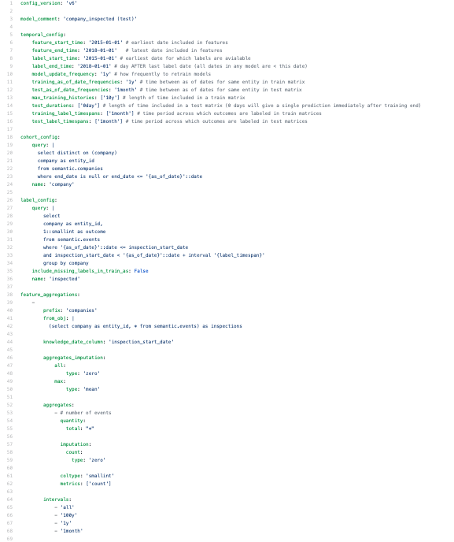
config.yaml
https://github.com/dssg/direccion_trabajo_inspections/blob/master/experiments/test.yaml

